Slide 1
Global Road Safety and Activities of the Towards Zero Foundation
Automotive Safety Council Annual Meeting
Bonita Springs, FL – 19 March 2022
Adrian Lund, Ph.D.
Trustee, Towards Zero Foundation

Slide 2
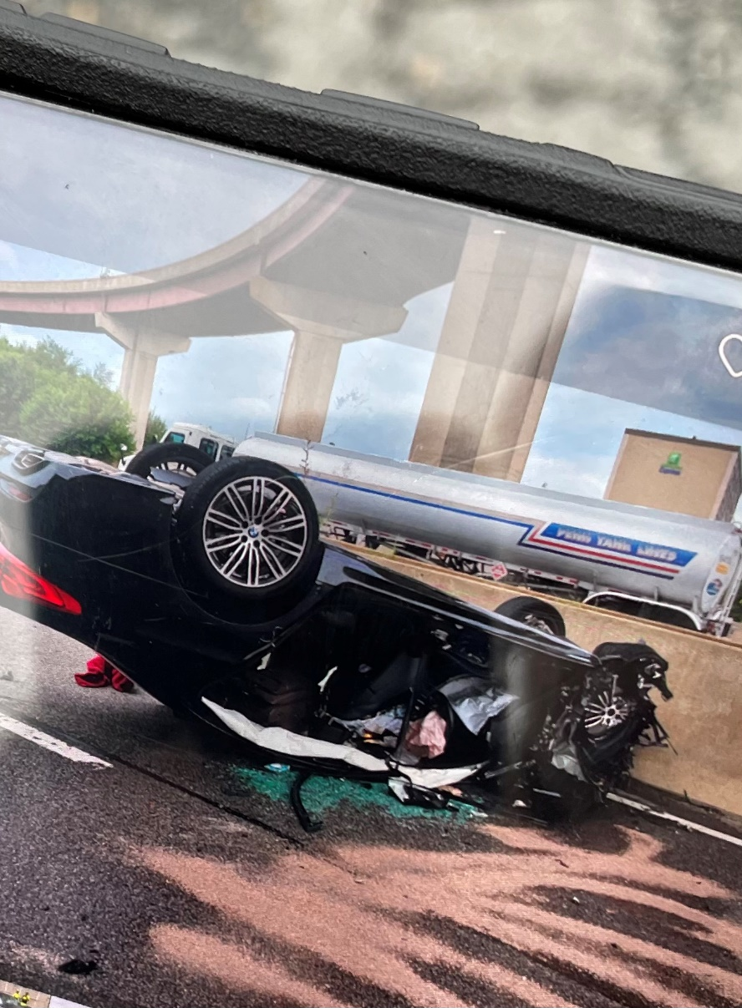
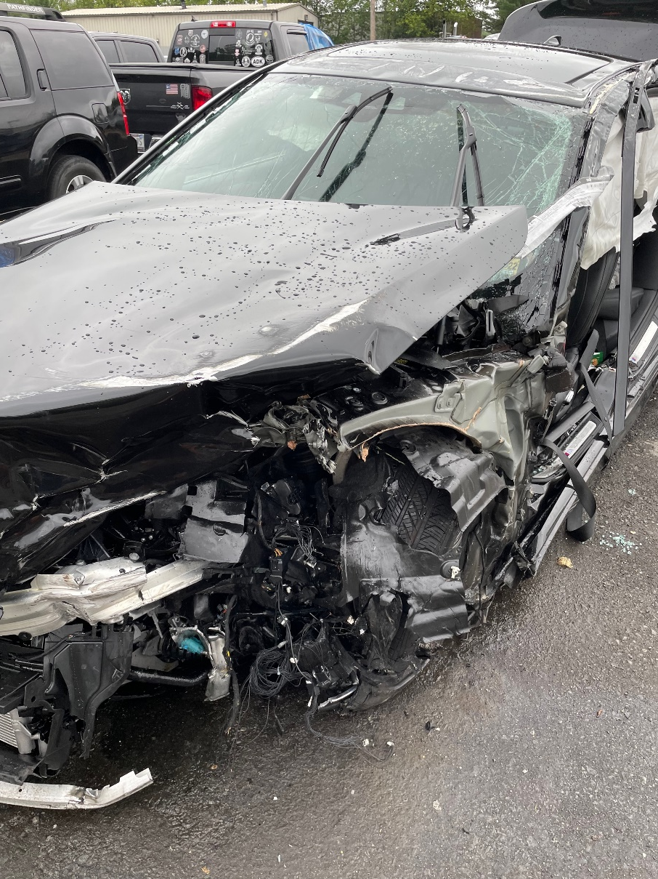
A Thank You for What You Do

Slide 3
Global NCAP is now Towards Zero Foundation
Which is …
A UK registered charity working internationally for a world free from road fatalities and life changing serious injuries by promoting safe and sustainable road transport.
The Foundation endorses the ‘Safe System’ approach to guide journeys ‘towards zero’ and provides a platform for global partnerships working for ambitious improvements in public health on our roads, and supporting the transport related United Nations’ Sustainable Development Goals.
The TZF’s current major projects include:
The Global New Car Assessment Programme
The Stop the Crash Partnership
The Commonwealth Road Safety Initiative
The ‘50 by 30’ campaign to halve global road deaths and serious injuries by 2030

Slide 4
Towards Zero Foundation
Principal officers
Chairman – Iain Cameron
President and CEO – David Ward
Secretary General GNCAP– Alejandro Furas
Secretary General TZF – Jessica Truong
Still funded principally by grants from
FIA Foundation
Bloomberg Philanthropies
Alexander Mosely Charitable Trust
Other national NCAPs support Global NCAP as Associate Members

Slide 5
50 by 30 – officially adopted by WHO October 2021

Slide 6
Stop the Crash Partnership
18-20 May ITF 2022 Summit: Transport for Inclusive Societies
Q3-4 2022 STC in Mexico with a focus on motorcycle ABS and ADAS
Focus on powered 2-wheeler safety in ASEAN region
A series of motorcycle ABS demonstrations in the lead up to the 28th ASEAN Transport Ministers
Meeting late in 2022
A report on powered 2-wheeler safety and important role of Motorcycle ABS

Slide 7
Global NCAP
Latin NCAP – initiated in 2010
https://www.latinncap.com/en/
ASEAN NCAP – initiated in 2012 (2011)
http://www.aseancap.org/v2/
Safer cars for India – initiated in 2014
http://www.globalncap.org/results/
Safer cars for Africa – initiated in 2017
http://www.globalncap.org/safercarsforafrica/

Slide 8
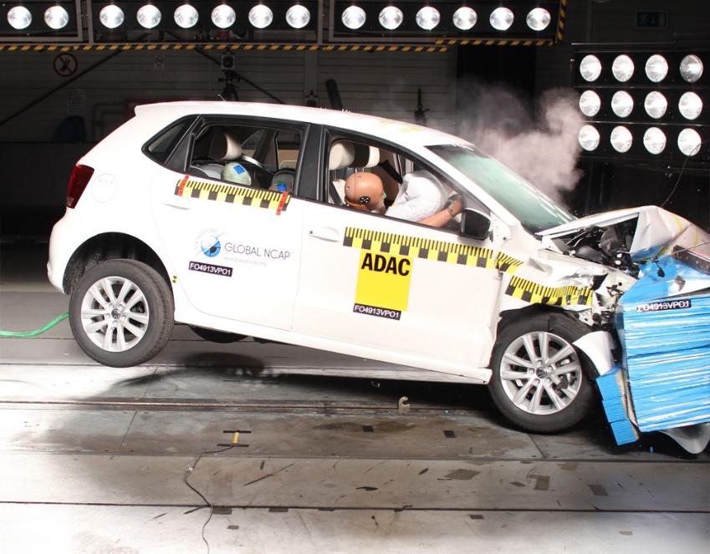
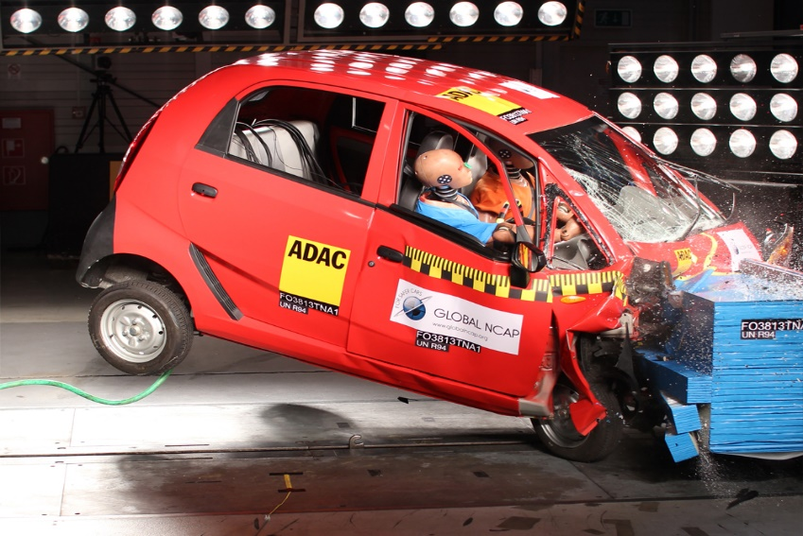

Slide 9
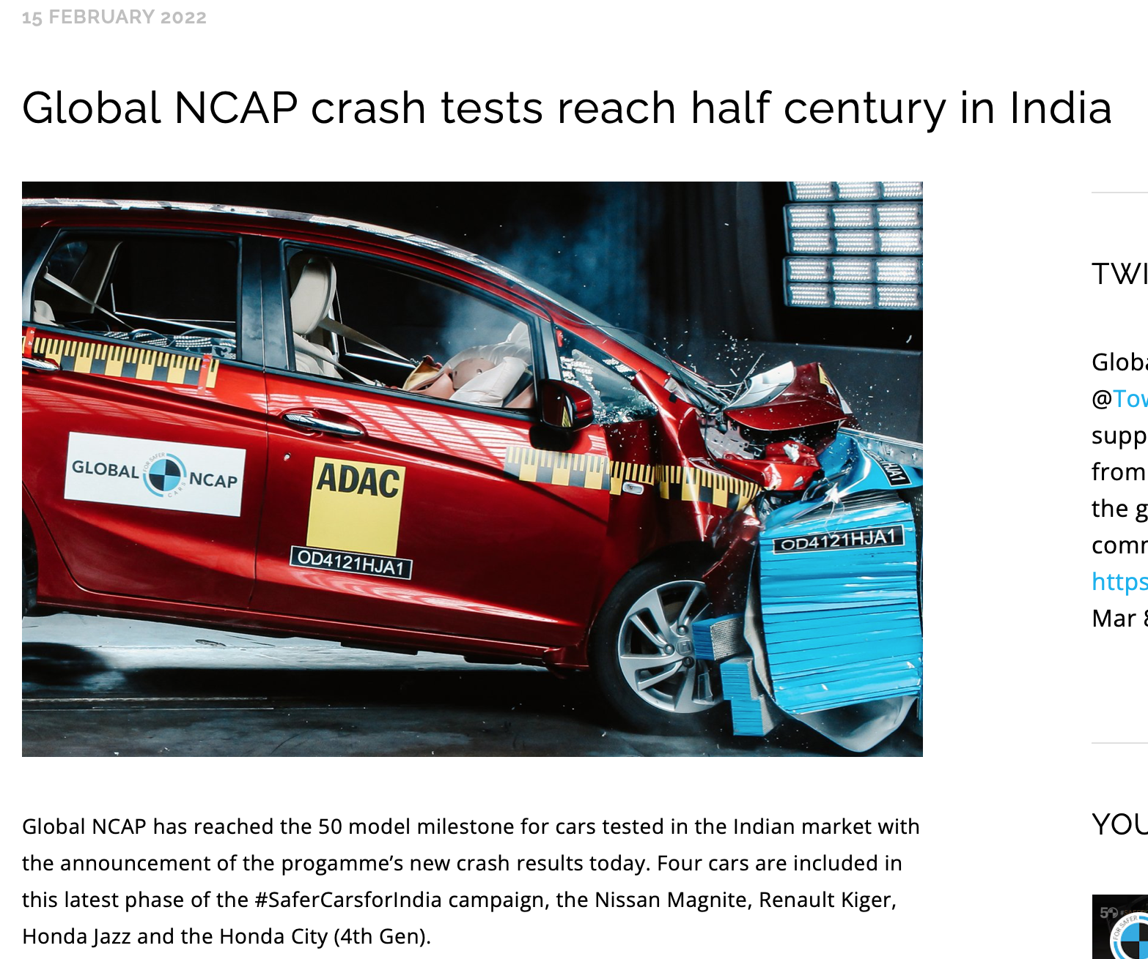

Slide 10
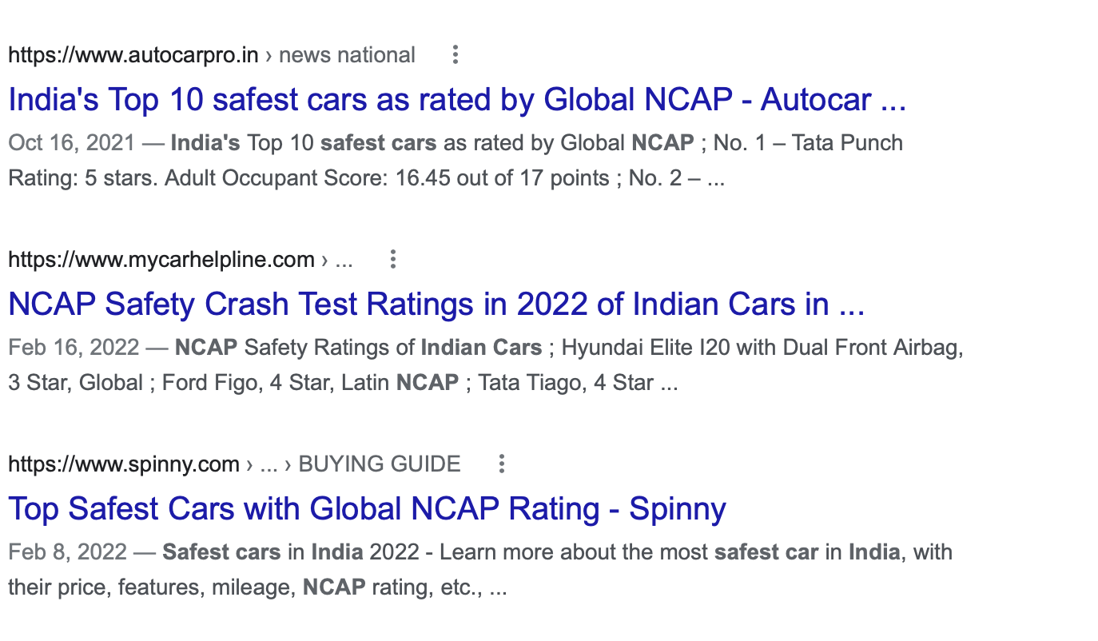

Slide 12
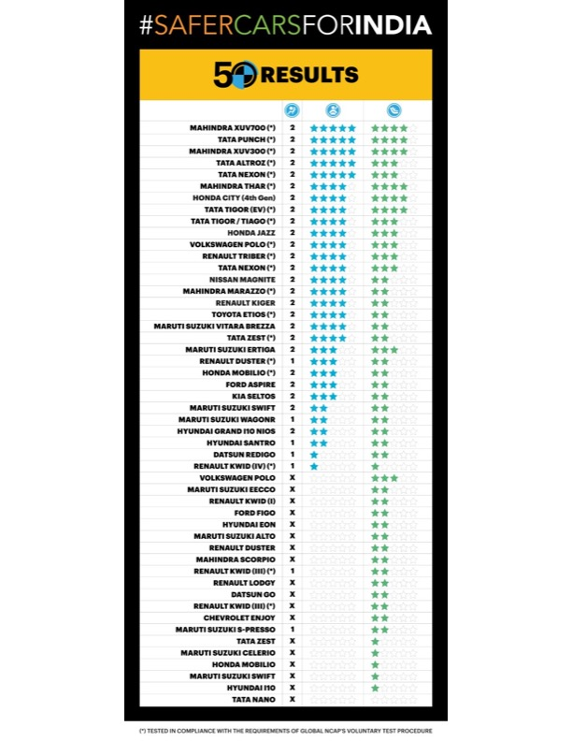

Slide 13
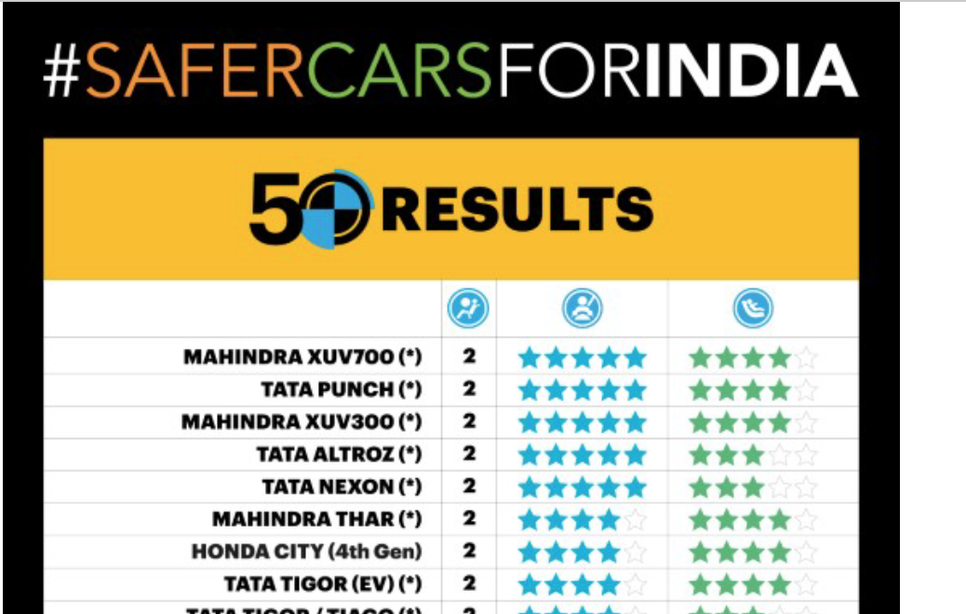

Slide 14
India is catching up with vehicle safety standards

Slide 15
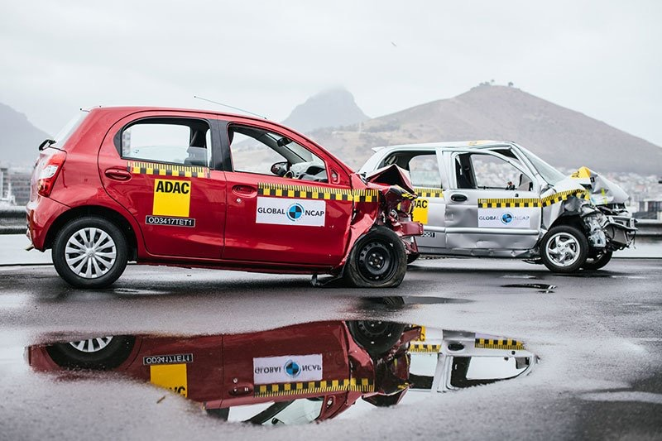

Slide 16
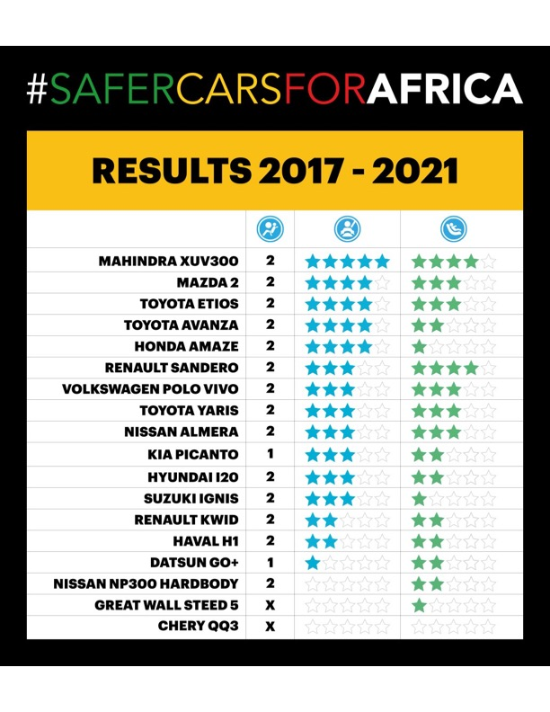

Slide 17
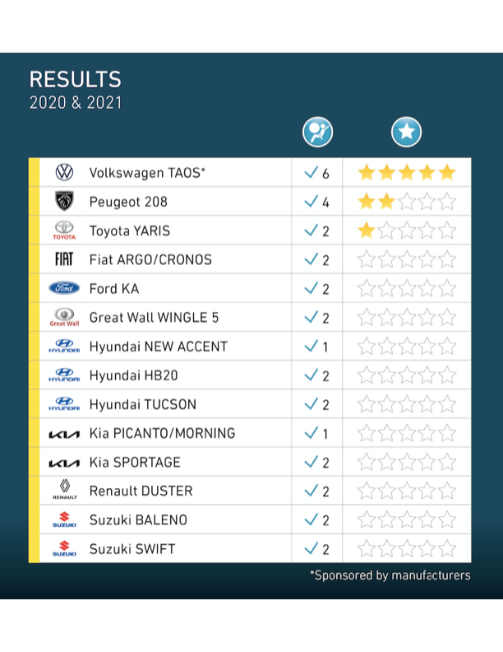
Latin NCAP

Slide 18
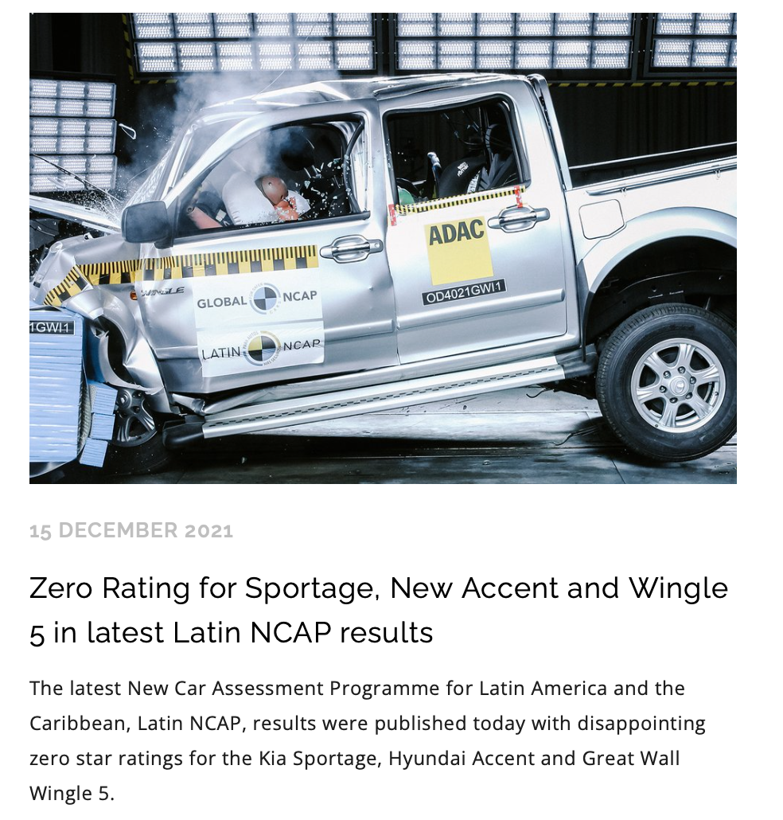

Slide 19
Thank you
Adrian Lund, Ph.D.
Trustee, Global New Car Assessment Program
@HITCH42LUND
AKLUND18@GMAIL.COM

